Slide 1

Week 1 — Introduction to Islamic Studies
Meaning, Reason & Revelation
NUST · ISLAMIC STUDIES · UNDERGRADUATE
"Can human beings live a meaningful and morally grounded life using reason and technology alone — or do we need a source of guidance beyond ourselves?"

Slide 2


Physical Sciences Explains How. What Answers Why?
HOW — Science Answers
WHY — Science Is Silent
How a bridge carries load. How an algorithm optimizes. How a satellite communicates.
What is a good life?
Why be moral when immorality benefits me?
💬 Think for 30 seconds — name one question science answers well, and one it cannot settle by measurement alone.
Notes:
Morality Standards Subjectivity
Physical sciences integration into Metaphysical Sciences
Concept of life after death and Accountability

Slide 3

What Is Religion?
More than rituals or private belief — religion functions as a worldview: a comprehensive lens on reality, meaning, and how to live.
Ultimate Reality
Meaning & Purpose
What exists? What is real?
Why are we here?
Morality
Identity & Practice
What ought we to do?
Who are we? How do we live together?
💬 Can two people agree on all scientific facts but still disagree deeply about what they ought to do? Why?
Notes:
Ultimate reality: Concept of yuminun bil ghaib
Meaning and Purpose: The existence of God and pleasing Him
Identity and Practice: Religion is universal and not based on culture diversities and civilization evolution

Slide 4
Why Do Humans Seek Meaning?
High grades, strong skills, a clear career path — and yet the question persists: Is this enough?
1
2
Meaning
Purpose
Why am I here at all?
What should I actually live for?
3
4
Morality
Mortality
What ought I to do — and why?
What happens when my life ends?
💬 Pair discussion: What is the difference between being successful and living a successful life?

Slide 5
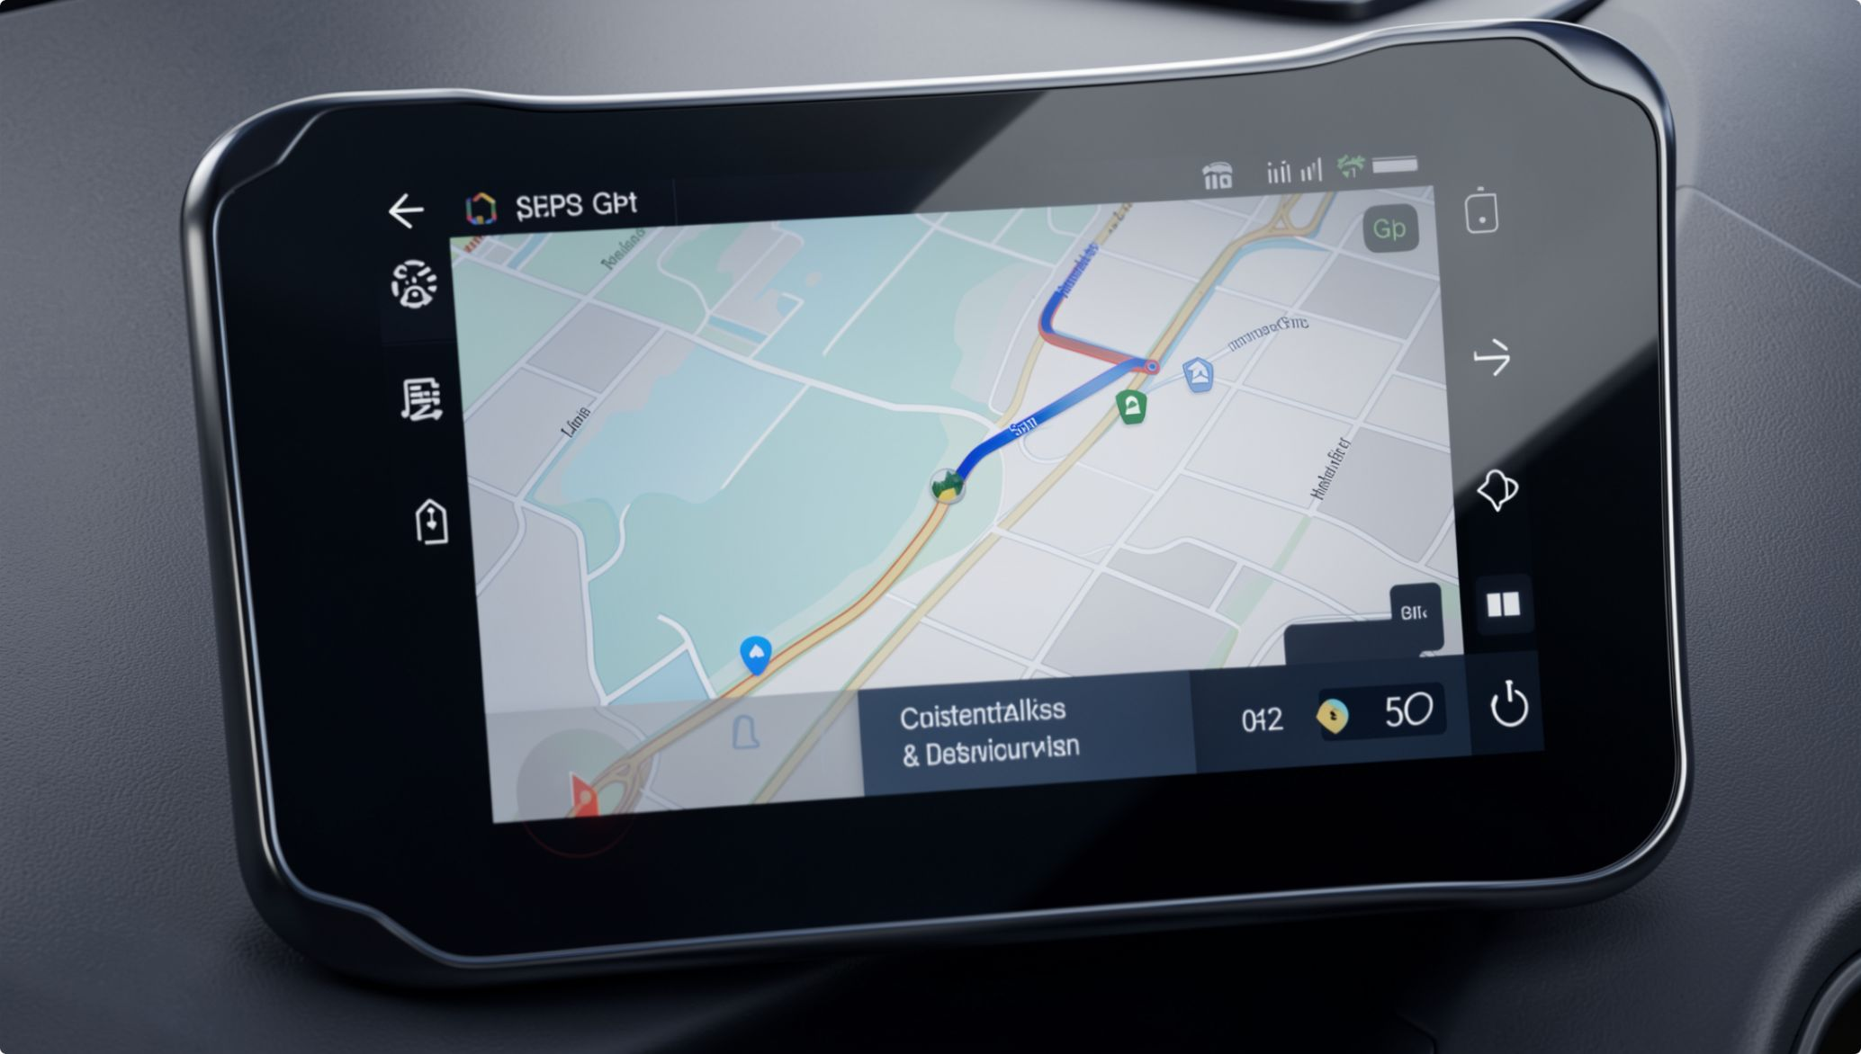
ENGINEERING ANALOGY
The Navigation Problem
A GPS system calculates the fastest route to any destination with extraordinary precision.
But it cannot tell you whether the destination is worth reaching.
Instrumental Goals
Ultimate Goals
"I study engineering to get a good job." — Reason optimizes the path.
"What makes a life worth living?" — Technology cannot decide the destination.

Slide 6
Can Reason Alone Guide Us?
Islam does not ask you to abandon your intellect. Reason is powerful — and it has real limits.
✅ Strengths of Reason
⚠️ Limits of Reason
Investigate the observable world
Evaluate arguments and evidence
Recognize consistency and consequences
Limited access to unseen realities
Disagreement on ultimate moral foundations
Susceptibility to bias and self-interest
🖥️ Analogy: A powerful processor still gives the wrong result if the input data or assumptions are flawed.
Notes:
The concept of Saraab baqeeya …Sura e noor 39

Slide 7




Reason & Revelation — Not Versus
Reason Investigates
Observes, infers, tests arguments, applies principles to the world we can examine
Revelation Informs
Addresses ultimate reality, divine purpose, moral boundaries, and what lies beyond observation
Together
Reason helps us understand and apply; revelation grounds ultimate guidance
"Islam does not frame the choice as reason versus revelation — it asks how they work together."

Slide 8
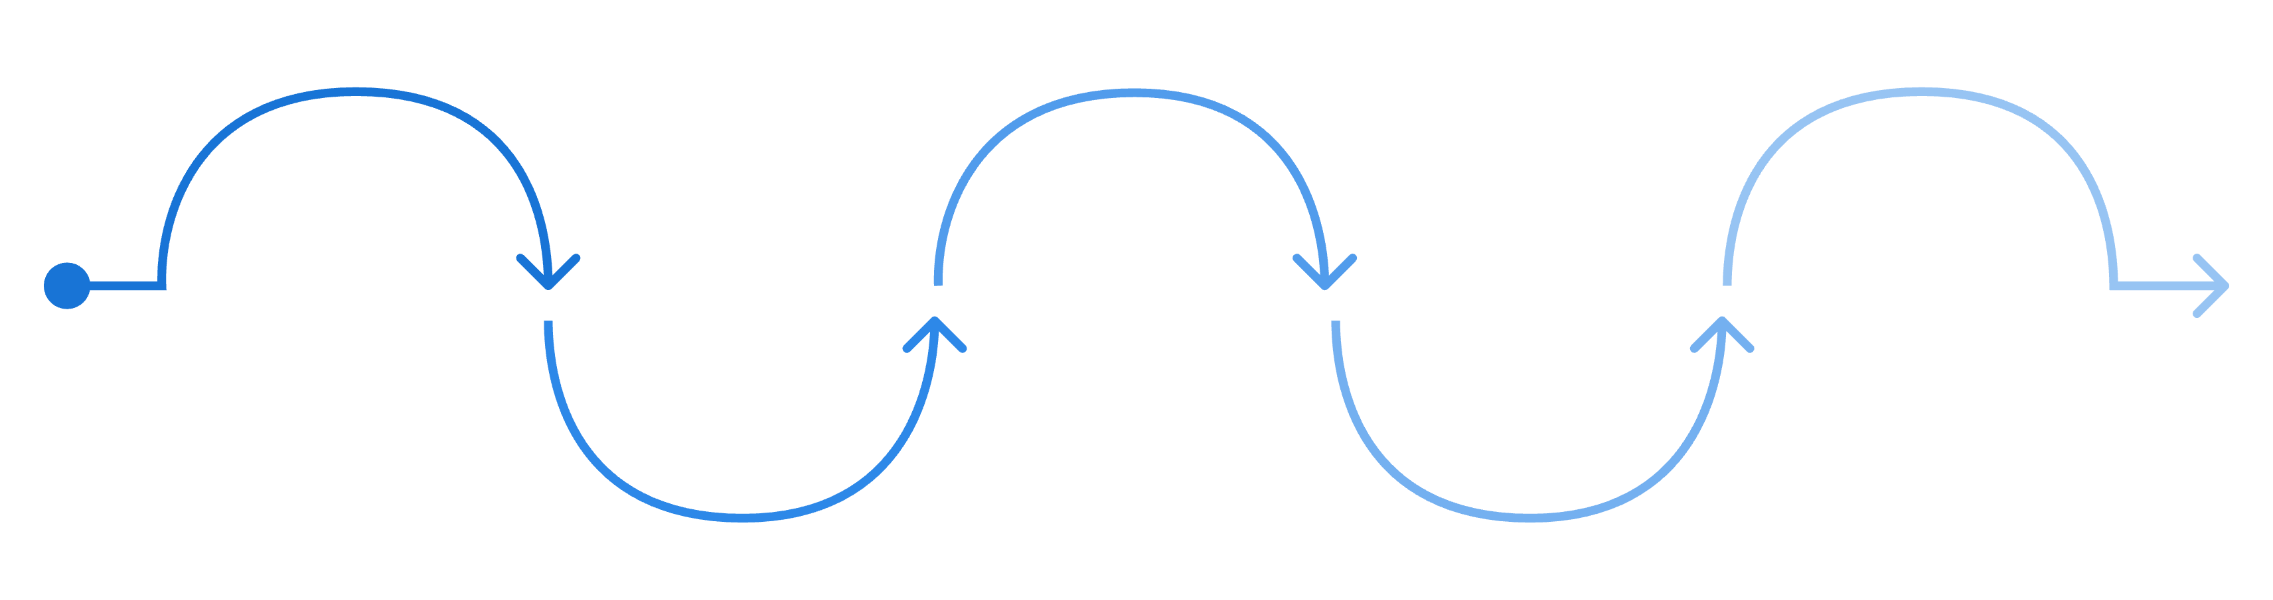
The Islamic Worldview
A coherent arc from human nature through to moral accountability.
Purposeful Action
Fitrah
Revelation
Reason
Worship as orientation and moral practice (Qur'an 51:56)
Accountability
Innate disposition toward truth (Qur'an 30:30)
Divine guidance beyond observation
Understand, interpret, and apply insight
Choices matter; moral responsibility (Qur'an 17:36)
Worship is not only ritual — it is conscious orientation, integrity in conduct, and responsibility toward creation.

Slide 9


Why This Matters — Now
"Can we?"
"Should we?"
Engineering capability: AI surveillance, deepfakes, autonomous weapons, persuasive algorithms
Ethics asks what consequences, harms, and rights are at stake for individuals and communities
"What are we responsible for?"
Islamic worldview connects technical decisions to moral accountability before God and toward creation
💬 Scenario: An AI engineer discovers a profitable model that systematically harms a vulnerable group. What should determine the decision — profit, legality, public pressure, or a deeper moral principle?
Notes:
Application of reasons and revelation

Slide 10

Activity: Draft Your Purpose Statement
2 MIN WRITE · 2 MIN PAIR · 3 MIN SHARE
Complete each line individually, then discuss with a partner:
Exit Ticket: "One idea from today that challenged my assumptions is…"
Next week: The Qur'an — its nature, revelation, and intellectual tradition.
"I want to use my knowledge and abilities to…"
"…because I believe…"
"…and I am responsible for…"

